Slide 1
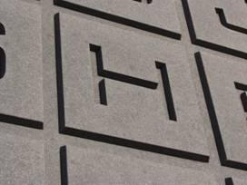
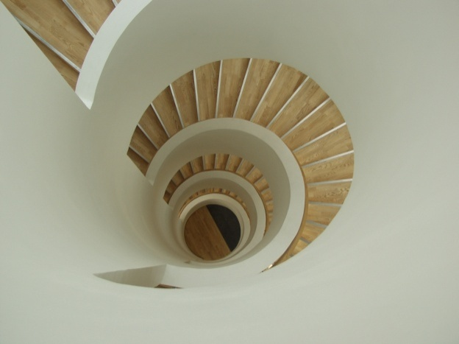
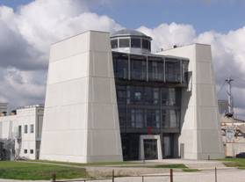
T h e F u t u r e o f C o n c r e t e
U n l o c k i n g t h e P o t e n t i a l s

Slide 2
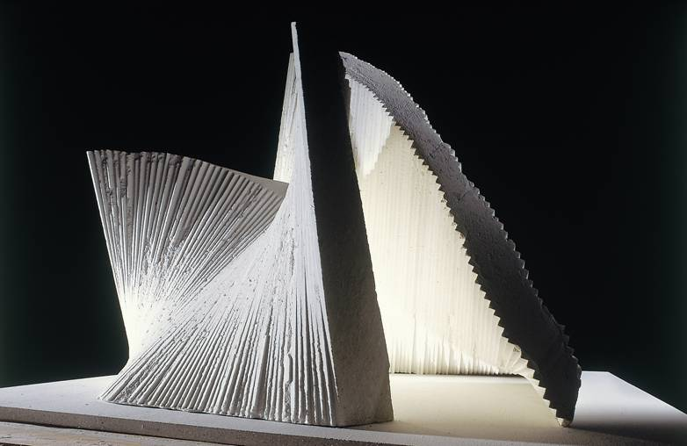
C o n c r e t e h a s n o L i m i t s ?
Challenging Concrete

Slide 3

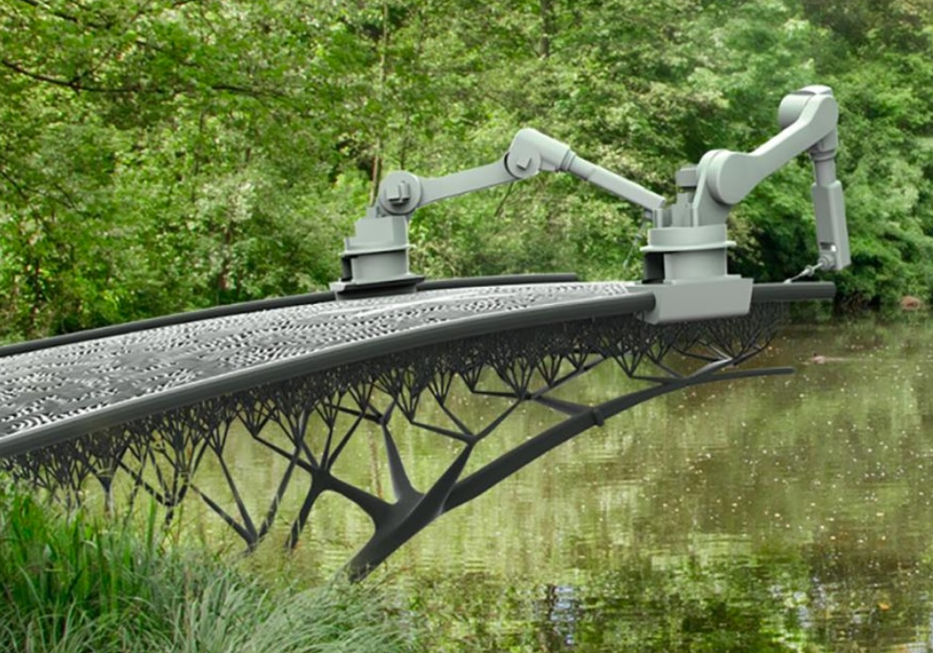
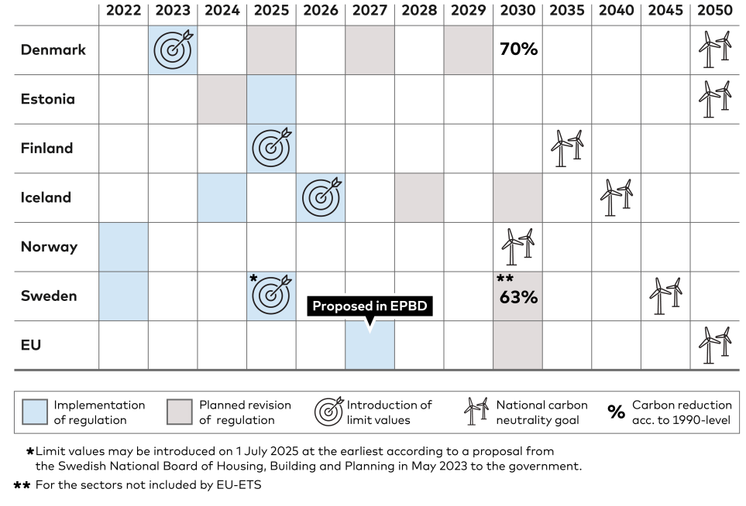
CSRD
ESG
EPD
12 kg CO2e
10,5 (2025)
9,0 (2027)
7,5 (2029)
LCA

Slide 4
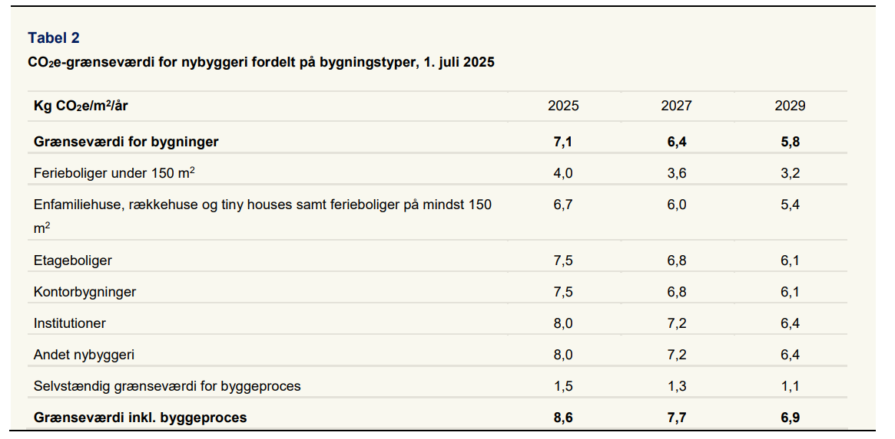

Vedtaget grænse pr. 01.07.2025

Slide 5

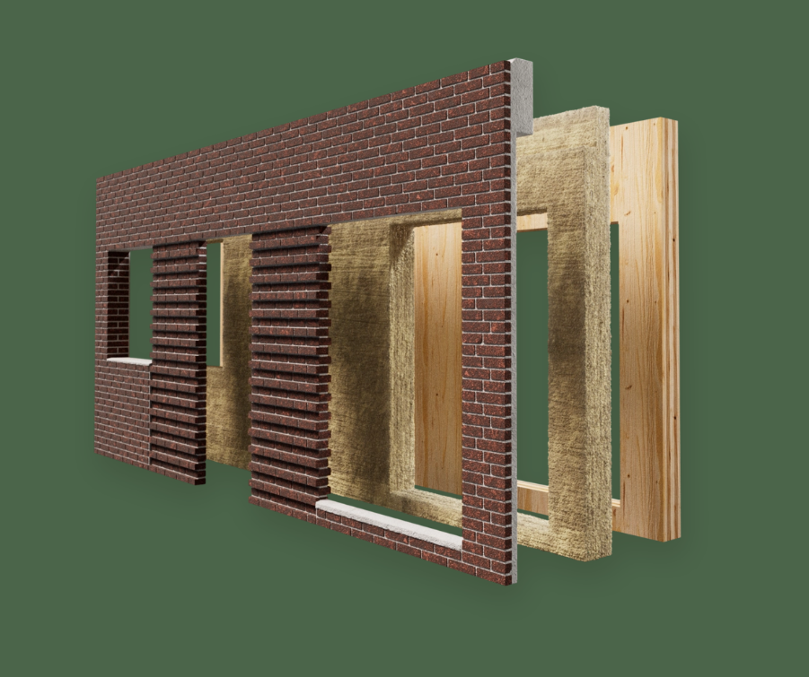

24.03.2025

Slide 6



7,5 kg CO2e
CSRD
DS1140
ESG
Architects
Engineers
Manufacturers,
Contractors
Owners,
Users
Market Mechanisms

Slide 7


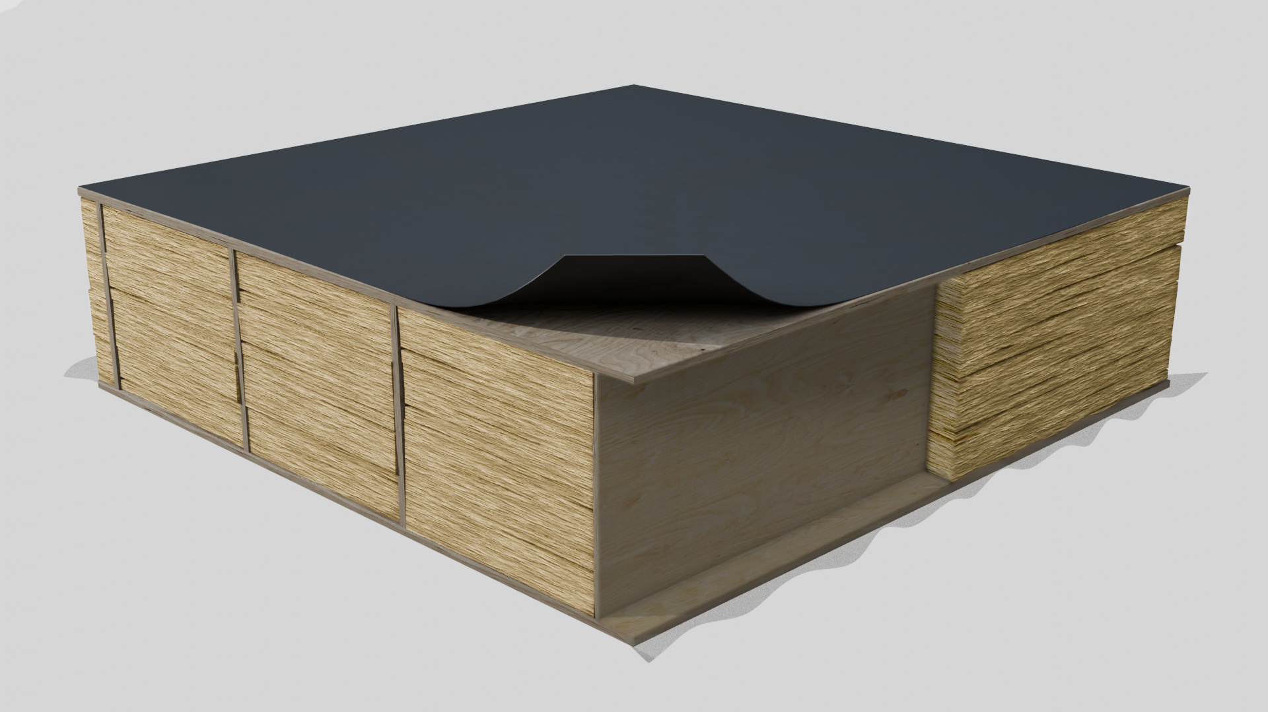
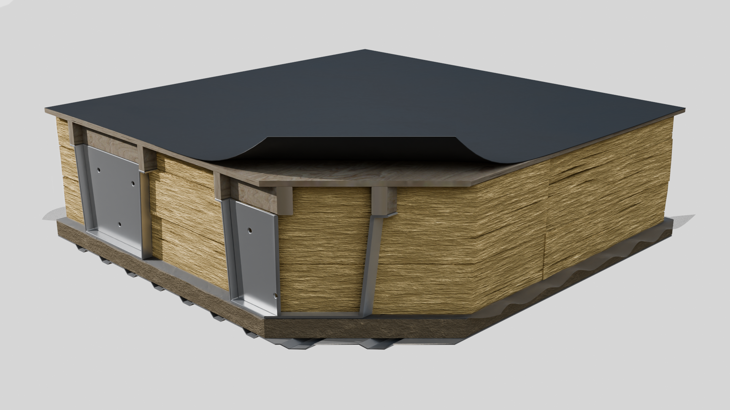
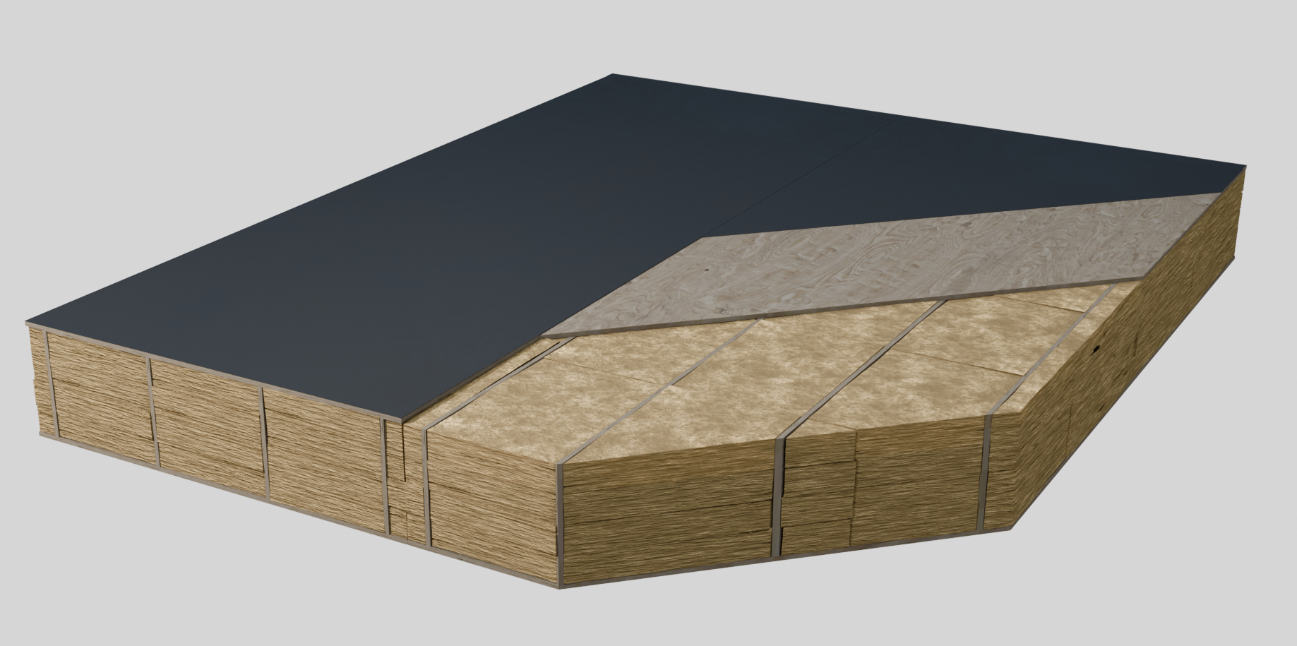
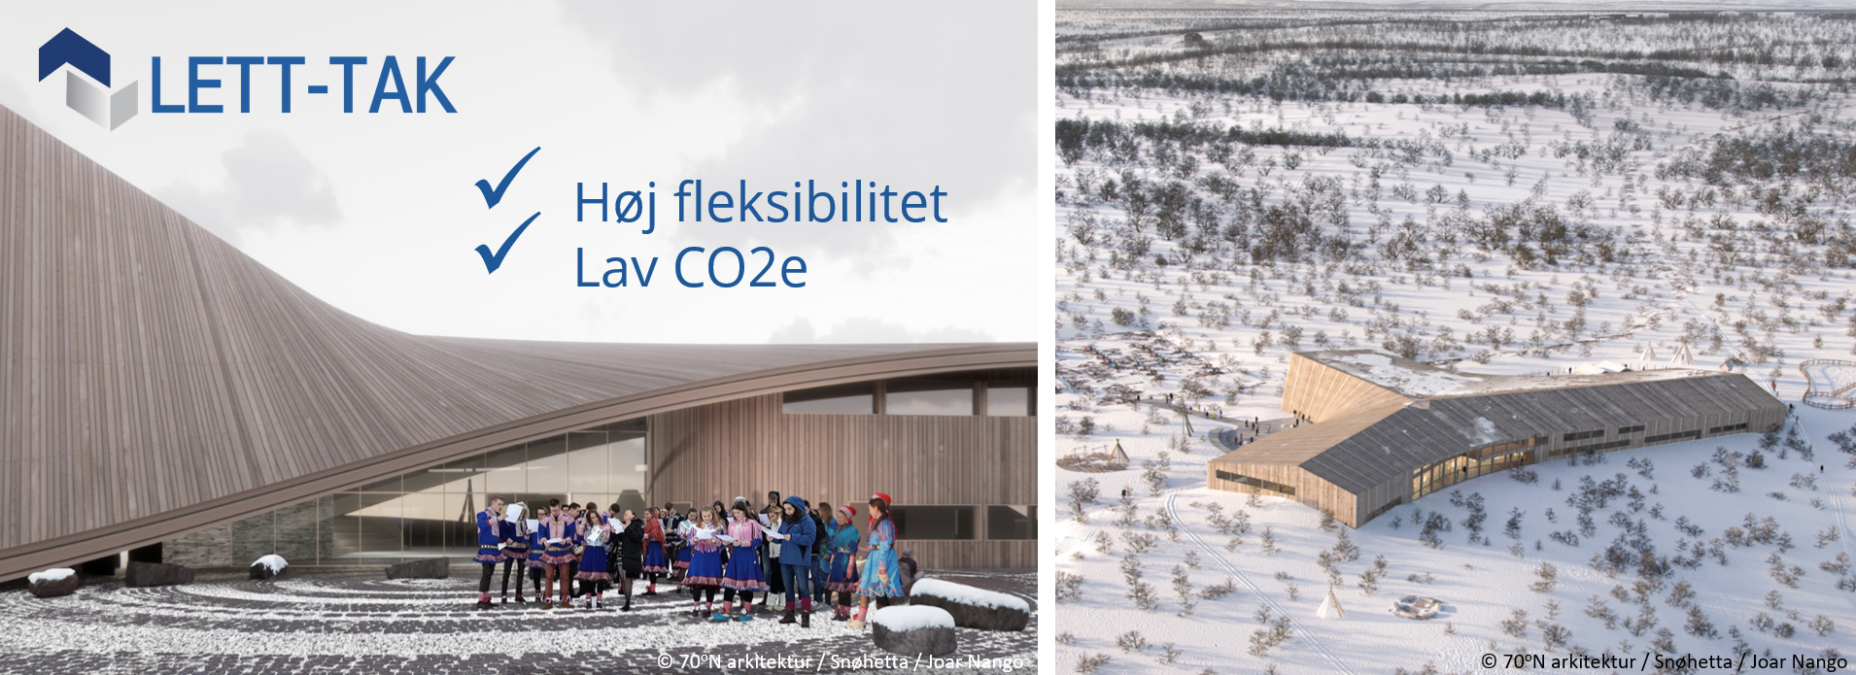
Lett-Tak Floor
24.03.2025

Slide 8
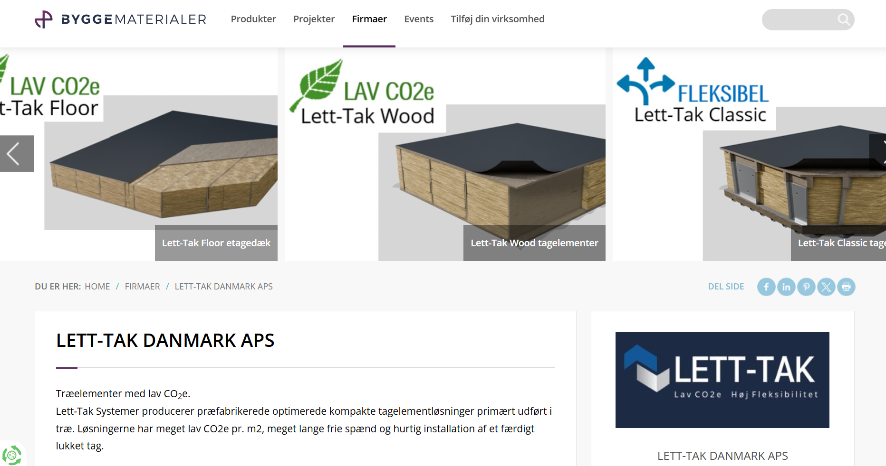

Slide 9
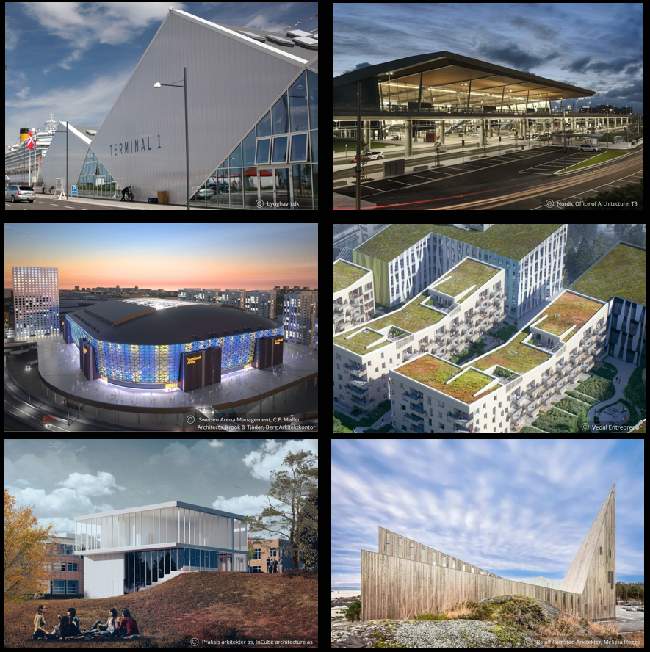
24.03.2025

Slide 10
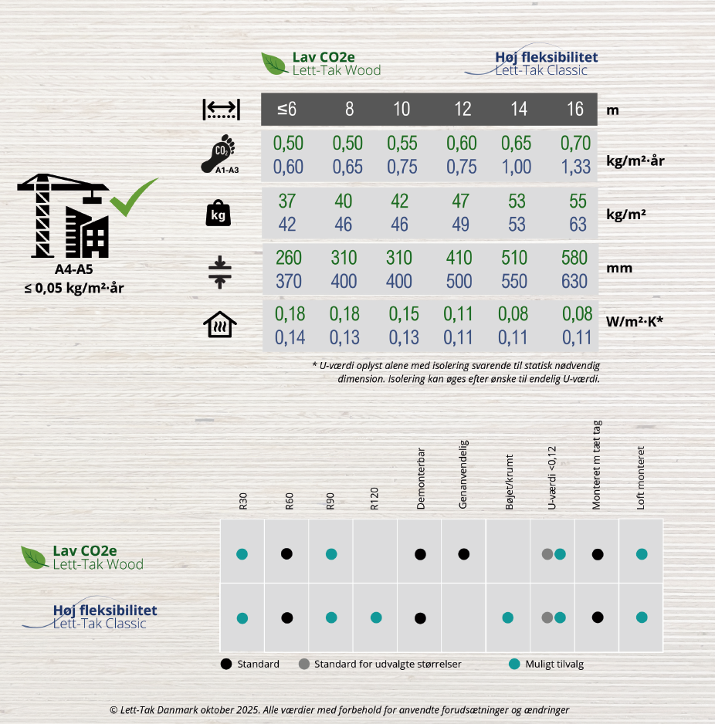
24.03.2025

Slide 11
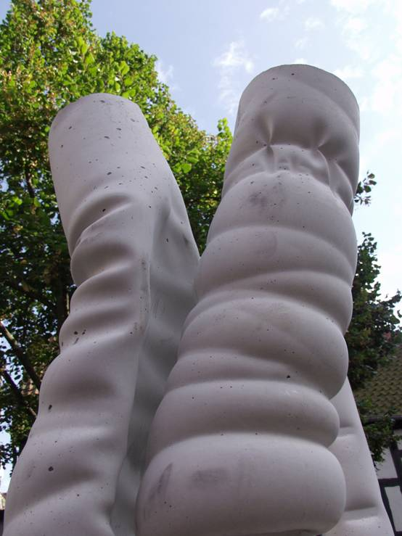
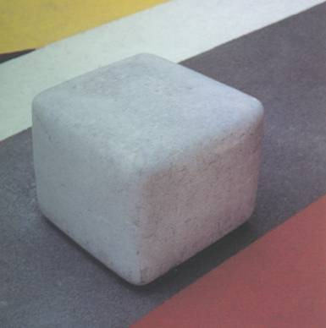

Slide 12
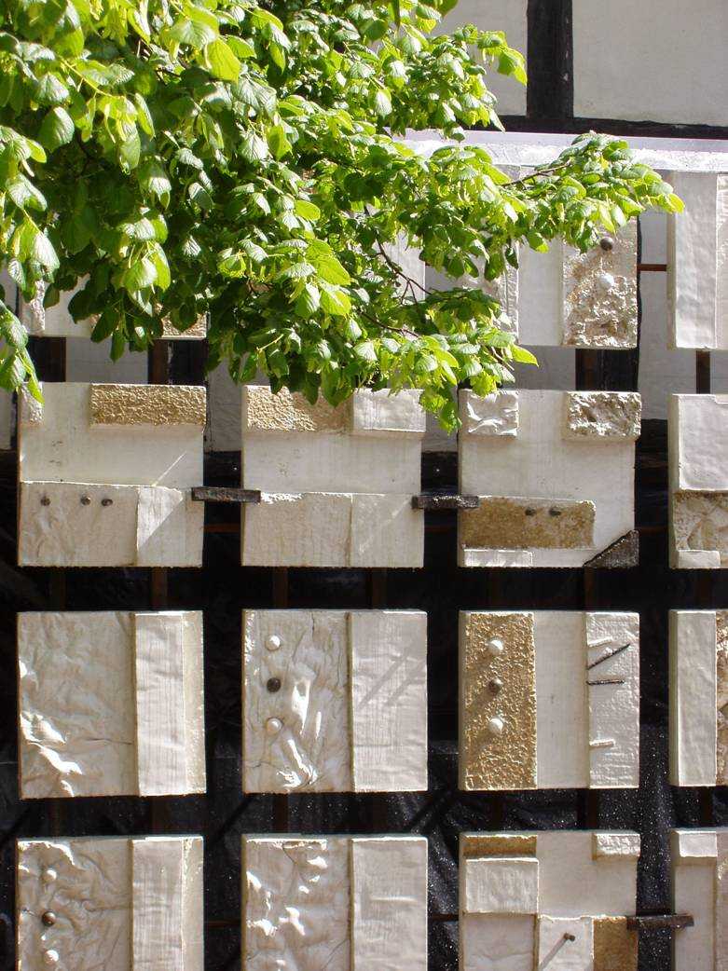

Slide 13
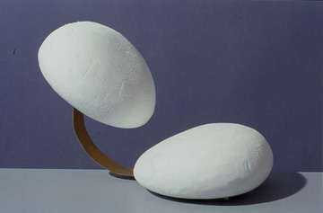
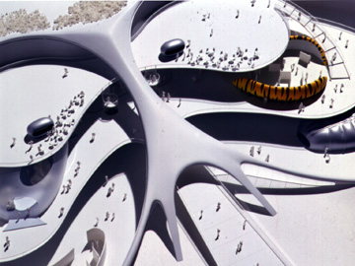

Slide 14
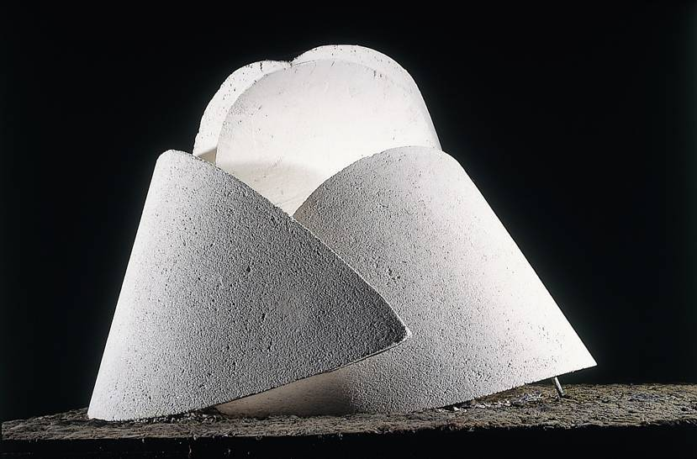
W h a t i s C o n c r e t e Q u a l i t y ?

Slide 15
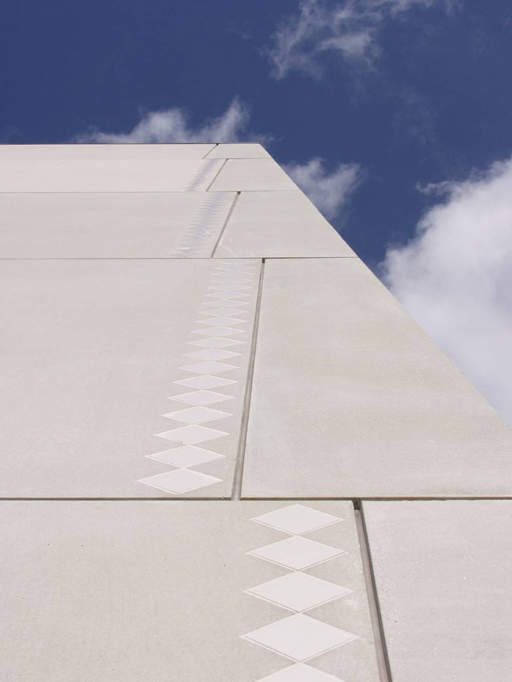
Old Values
Consistent
Artificial
Mechanical
Safe
Planned
Regimented
Distant
Rigid
Crisp
Control
Homogeneous
Bound
Subdued
Manufactured
Simple
Shallow
Defined
Future Values
Variegated
Natural
Human
Vulnerable
Serendipitous
Individual
Intimate
Flowing
Soft
Acceptance
Complex
Bold
Outspoken
Organic
Layered
Deep
Experienced
Concrete Quality
Problem
Solution

Slide 16

Sand
Sten
Vand
What is Concrete?
Cement
Grå
Hvid

Slide 17
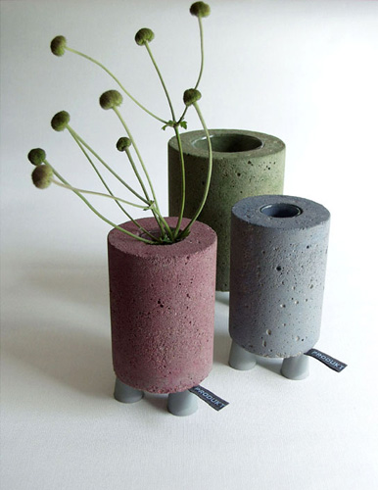
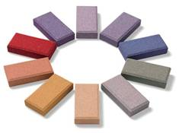
Colour Pigments

Slide 18

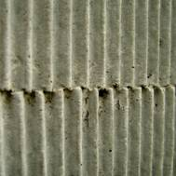
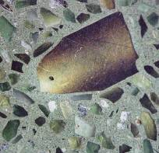


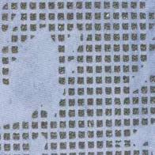
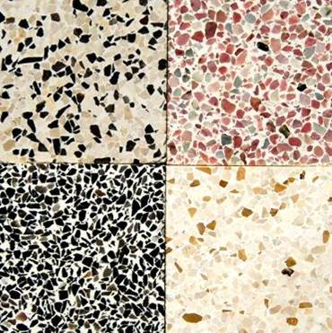
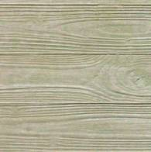
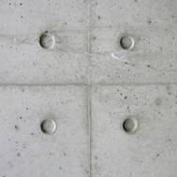
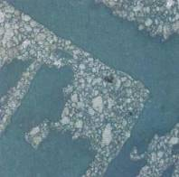
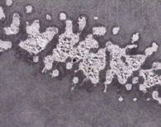

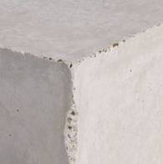
Notes:
.

Slide 19
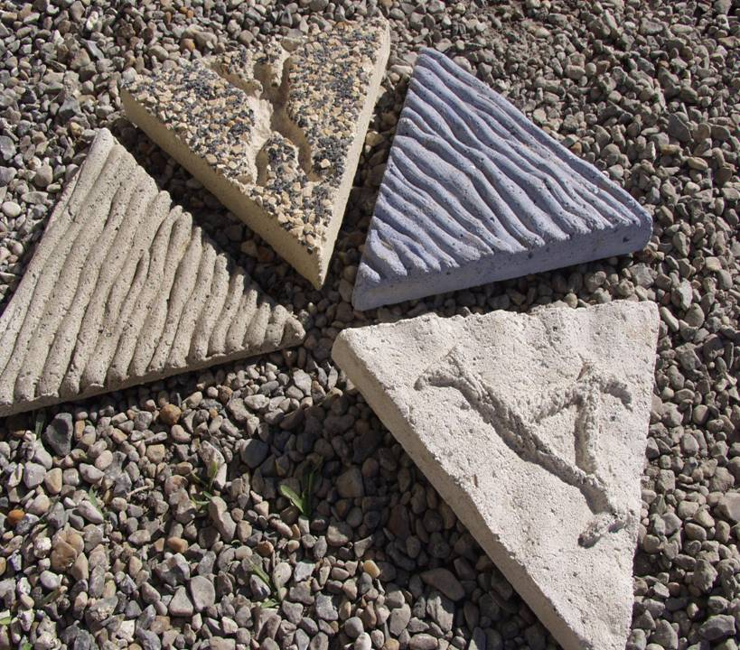

Slide 20
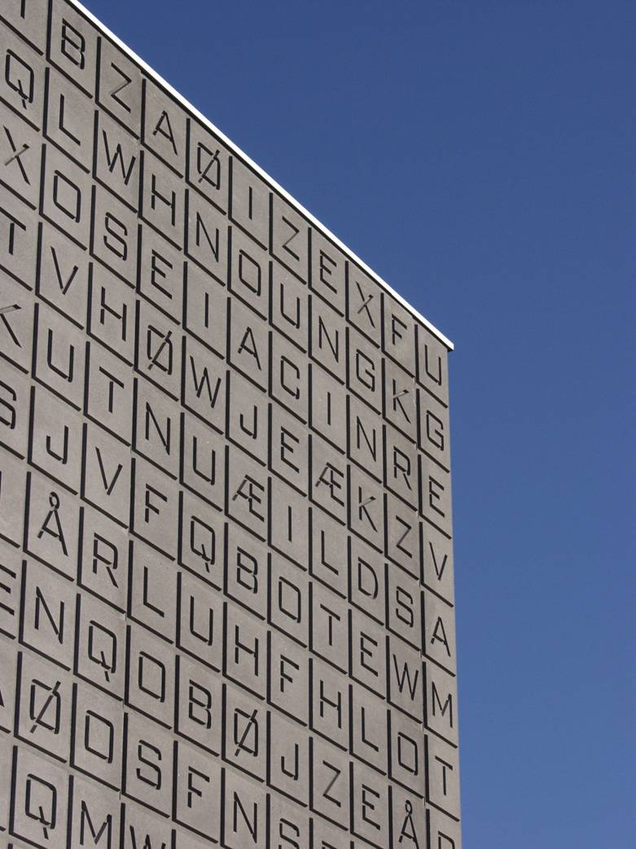

Slide 21
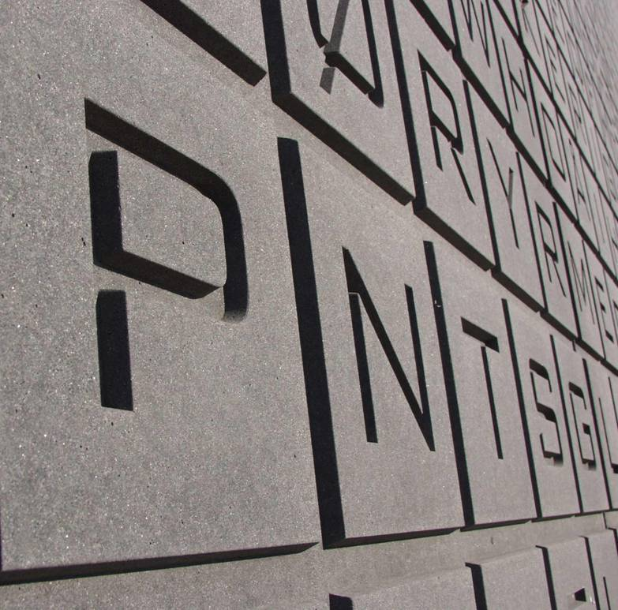

Slide 22
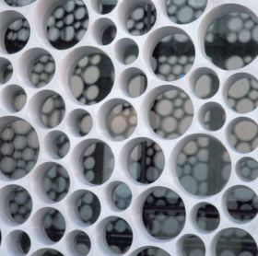
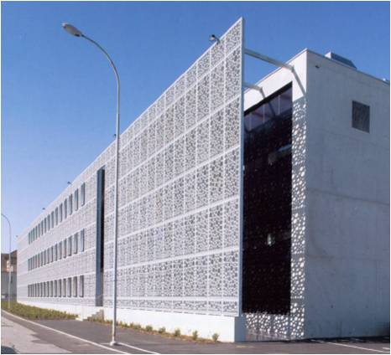

Slide 23

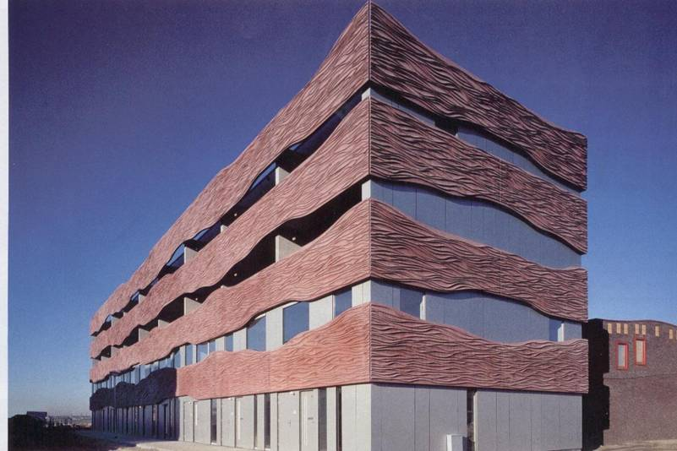
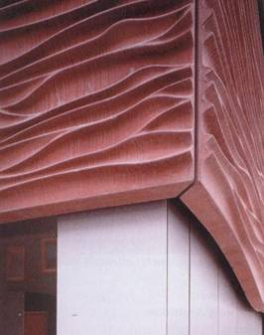

Slide 24
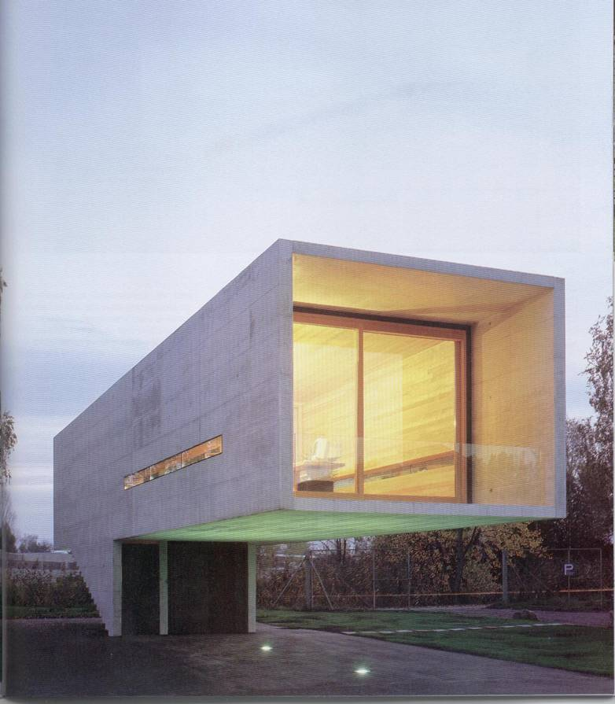

Slide 25
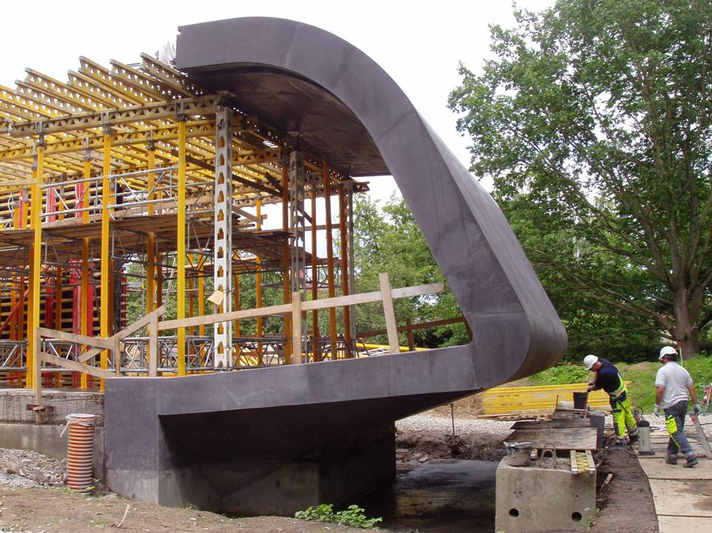

Slide 26
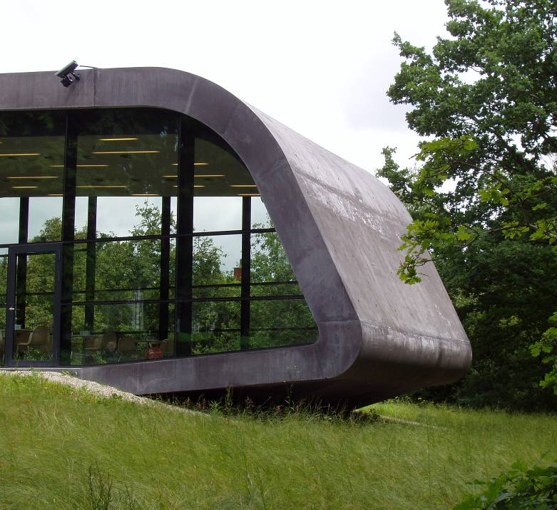

Slide 27
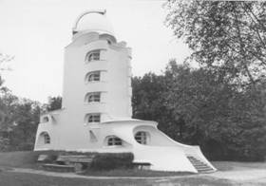
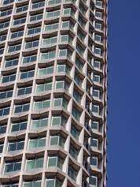
Craftsmanship + Individuality =
Industry + Standard =
Future Designs
?
Mass Customization
Individuality + Industry =

Slide 28
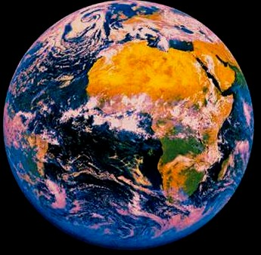

SUSTAINABILITY
ENERGY & EMISSIONS
AESTHETICS
FUNCTION
FLEXIBILITY
INDIVIDUAL
F U T U R E
C O N C R E T E
S T R U C T U R E S

Slide 29
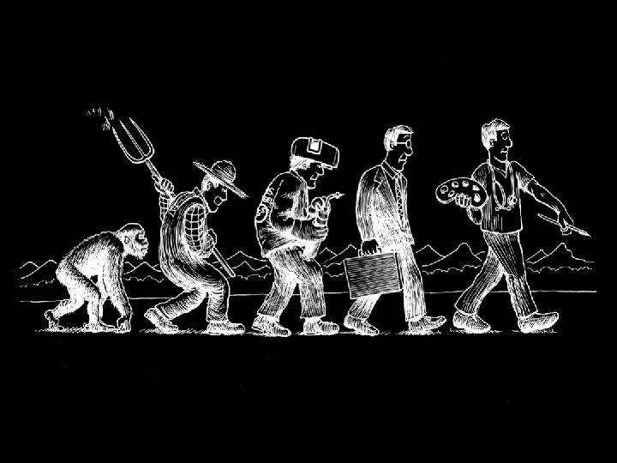
Industrial Society
Dream Society
Creative Man Society
Individuality

Slide 30

Individuality

Slide 31
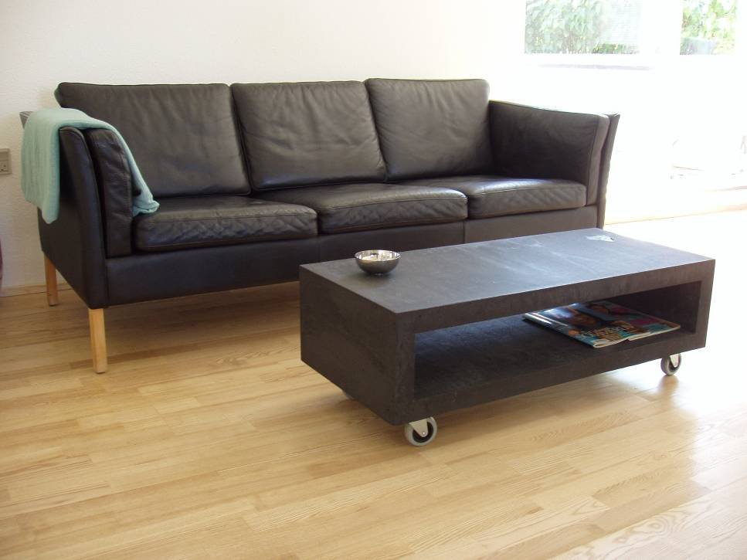
Future Market

Slide 32
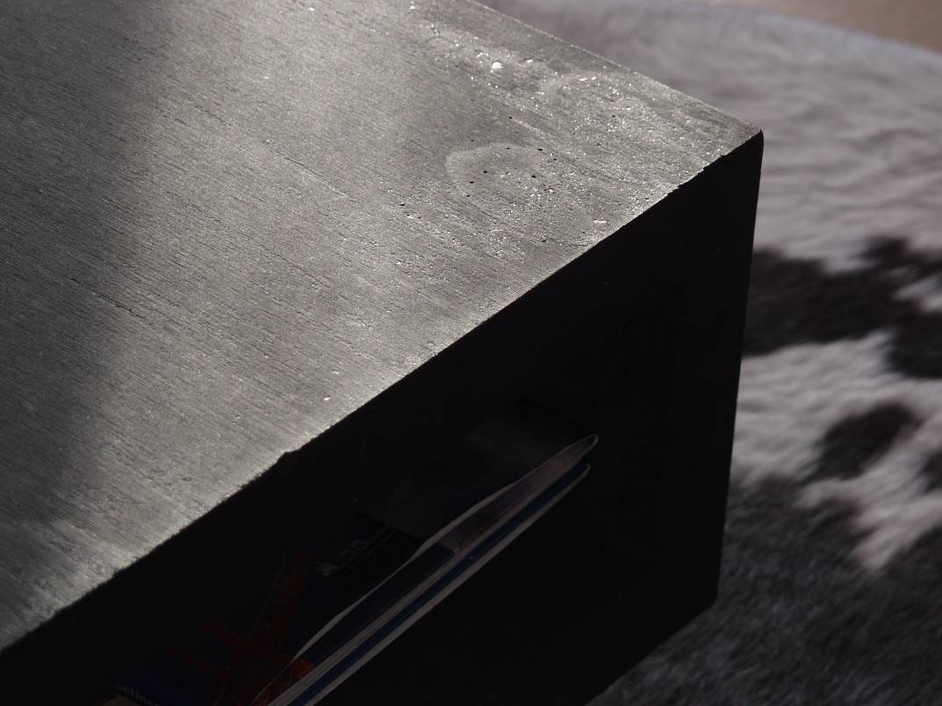
Future Market

Slide 33
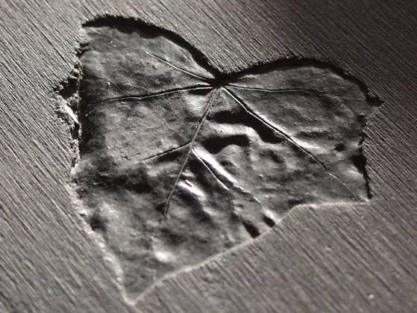
Future Market

Slide 35
Individuality

Slide 36


Slide 37



Slide 38




Slide 39

AESTHETICS
FUNCTION
National Assembly, Kuwait

Slide 40


National Assembly, Kuwait

Slide 41

Utzon

Slide 42

T H E C O N C O U R S E B E A M

Slide 43

T H E C O N C O U R S E B E A M

Slide 44



Structural Concrete

Slide 45

Patina ?

Slide 46

Patina ?

Slide 47


Patina ?

Slide 48

Patina as a Discipline

Slide 49


Slide 50



Slide 51


Precast Concrete

Slide 52

In-situ Concrete

Slide 53

In-situ Concrete

Slide 54

In-situ Concrete

Slide 55

In-situ Concrete

Slide 56

In-situ Concrete
In-situ Concrete

Slide 57





In-situ Concrete

Slide 58



In-situ Concrete
Notes:
Bagsværd Kirke tegnet af Jørgen Utzon. Bygget i 1976.
Hvid cement er brugt til mange forskellige formål:
Fliser er blødstøbte.
Interiør er hvid terrazzo.
Mørtel specialfremstillet mørtel med kalk og hvid cement.

Slide 59


In-situ Concrete
Notes:
Bagsværd Kirke tegnet af Jørgen Utzon. Bygget i 1976.
Hvid cement er brugt til mange forskellige formål:
Fliser er blødstøbte.
Interiør er hvid terrazzo.
Mørtel specialfremstillet mørtel med kalk og hvid cement.

Slide 60
Energy, Emission & Sustainability

Slide 61

Required Interior Temperature 31±1°C
Actual Exterior Temperature 3 – 42 °C
Back to Basics

Slide 62

Back to Basics

Slide 63

- Natural Airflow / Ventilation
- High Thermal Mass
Back to Basics

Slide 64


Exposed Thermal Mass
Thermal Mass

Slide 65



Global Trends in the Housing Industry
Savings needed on energy consumption
Savings needed on construction resources
= 25%
Notes:
25% af udgifterne til et byggeri er kvalitetsomkostninger
Spar på energien
Tykke vægge gør boligen mindre

Slide 66

Challenge Concrete

